Slide 1
Eye tracking with CNN
Ágoston Csehi (Guszti)
AIT Deep Learning course 2021/1

Slide 2
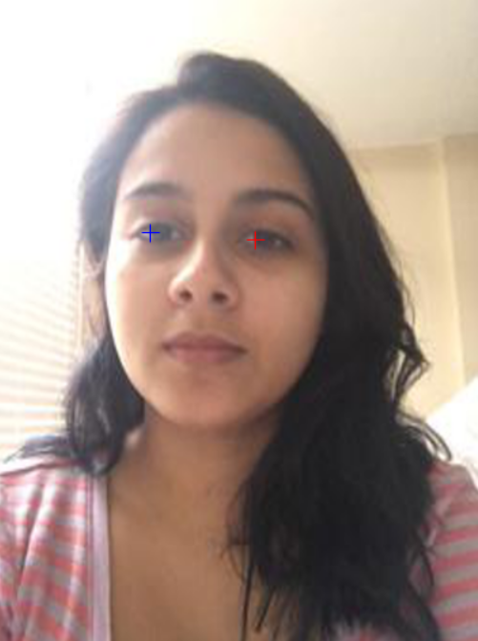
Task
Eye position
Regression
2D-3D

Slide 3
GazeCapture
1,490,959 frames
Apple
Metadata: positions, frame sizes…
~150GB

Slide 4
Preprocessing
Resizing 256x256
CSV
(augmentation, discussed later)
Decompression-compression

Slide 5
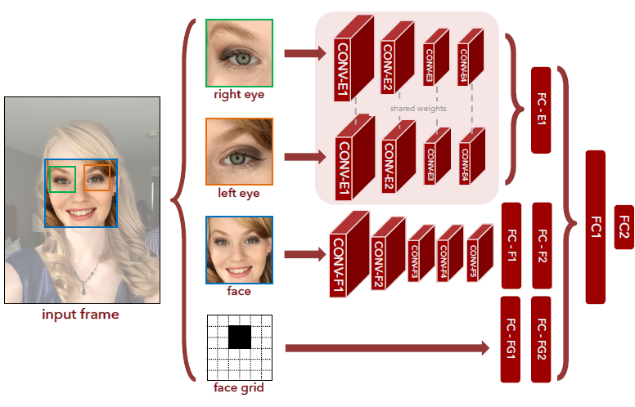
Network
Pooling
Zero padding
Depth

Slide 6
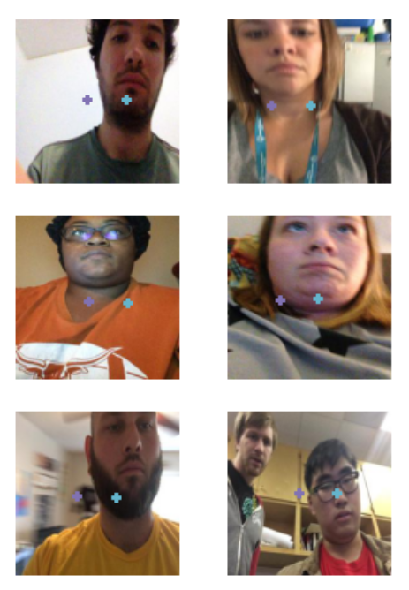
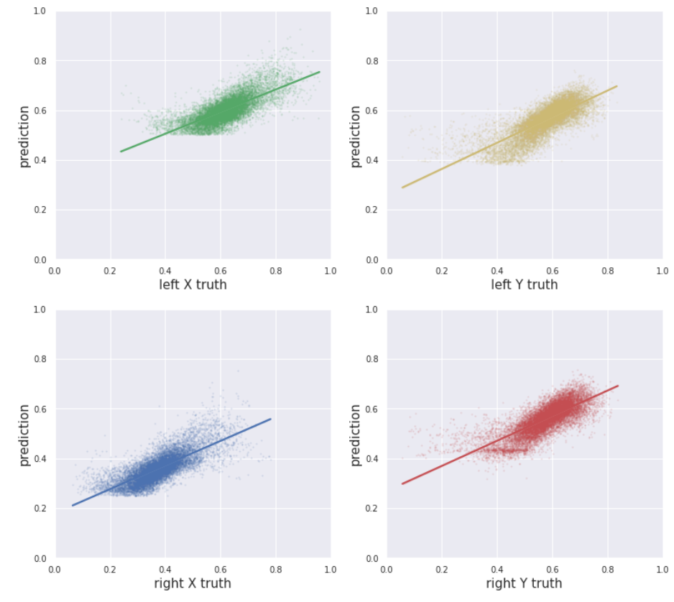
Evaluation
Batch size
Pooling
Zero padding

Slide 7

Demo
Misconfiguration
Noisy training data
A little cheat…

Slide 8
Thank you for your attention!
Questions?

